Slide 1
How is Energy Transferred on Earth?

Slide 2
Energy Transfer on Earth
Most of Earth’s energy is in some way derived from the sun.
Even energy sources such as Hydro (energy from falling water) and Coal can be traced back to the sun.

Slide 3
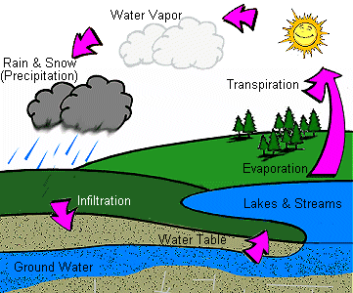
Energy Transfer on Earth
For example:
  Hydro requires the water cycle which is driven by the sun.

Slide 4
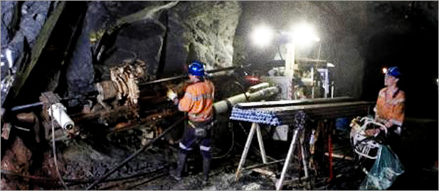
  For example:
    Coal, oil, natural gases are made of what was once living material. (these either used the sun directly as an energy source, or ate organisms that did).

Slide 5
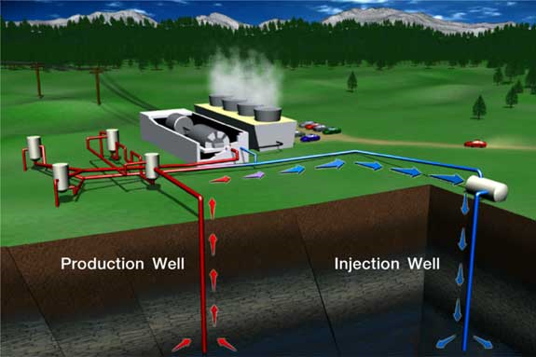
There are really only a few non-solar sources of energy on Earth
e.g. → wind energy and geothermal energy

Slide 6
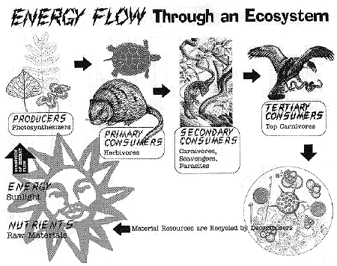
Food energy for the vast majority of ecosystems has as its source the photosynthetic activity of the producers in the ecosystem. There are one or two examples which do not use solar energy.

Slide 7
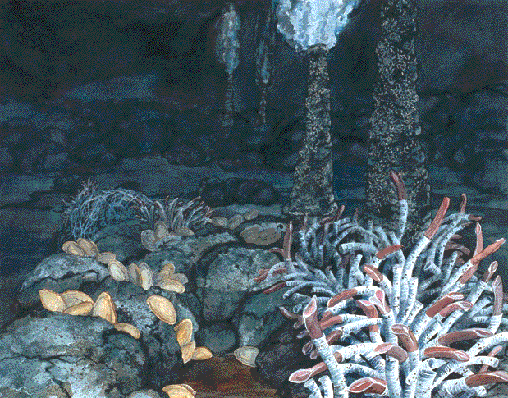
“Black Smokers” diverse ecosystems surround the warm hydrothermal vents at the bottom of the sea, far away from any sunlight. Organisms here can use chemicals emitted from the vent for metabolism.

Slide 8
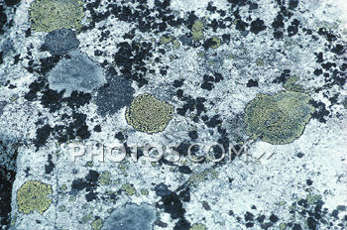
Organisms metabolizing minerals deep within fissures in rocks.

Slide 9
What is Energy?
Being that ecology is the study of the economics of nature, it makes sense that there should be some sort of currency. This “currency” is E. (energy)
Nature is governed by physical laws. Laws that concern the transfer of energy are known as the laws of thermodynamics.

Slide 10
Laws of T.D.
1) Energy exists in many forms
2) Energy cannot be created or destroyed but it can be converted into different forms
3) In all conversions of energy, some of the initial energy will be lost as heat or other unusable forms.
e.g. Chemical energy in animals: can be converted into kinetic (movement) energy, as well as the energy needed to perform life functions.
E.g. a cheetah uses its energy to create motion, but, excess heat is also produced in the process.

Slide 11
In an ecosystem, all of the energy that exists in the consumers cannot pass up the food chain to the next trophic level.
Due to:
Some is used in life functions
lost as heat
indigestible material.

Slide 12
10% Rule of Thumb
In fact, a rule called the 10% rule of thumb can be applied to certain aspects of an ecosystem.
10% rule of thumb: Of all the energy residing in a certain trophic level (locked in chemical form in the tissues of organisms in that level) only 10% will be passed to the level above.
The consequence of this is that there is a lower amount of energy (stored as body tissue) the higher you climb in a food chain.

Slide 13
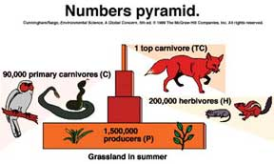
Ecological Pyramids
Energy flow among the trophic levels can be described using a model created by ecologists.
1) Pyramid of Numbers
Shows simply the number of
organisms at each trophic level.
These are the easiest for
ecologists to create
These pyramids can be inverted.

Slide 14
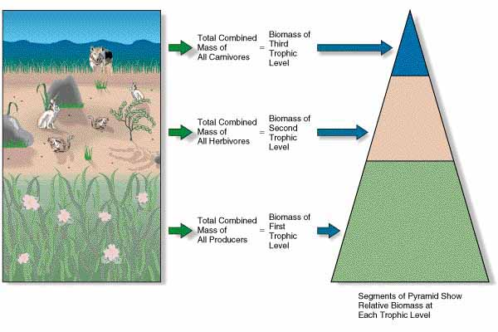
2) Pyramid of Biomass
Shows the mass of each type of organism at each level.

Slide 15
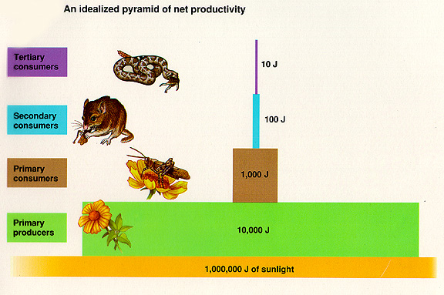
3) Pyramid of Energy
Shows how much energy (measured in Joules) is at each level of the pyramid.
Follows the 10% rule of thumb of energy transfer.

